Slide 1
Machine Learning in Business John C. Hull
Chapter 9
Model Interpretability

Slide 2
Why is model interpretability important?
Users must understand a model to have confidence in it, know when it is appropriate, be aware of its biases, etc
It is also important to be able to explain the predictions made by the model, e.g.,
Why was someone refused for a loan?
Why is house A worth more than house B
The General Data Protection Regulation in the European Union requires model interpretability

Slide 3
Amusing Stories
Hans: the horse that could do math
Image recognition software to distinguish dogs from polar bears

Slide 4
White-box vs black-box models
White-box models
k-nearest neighbors
Decision trees
Linear regression
Black-box models
SVM
Neural networks
Ensemble models (e.g. random forests)

Slide 5

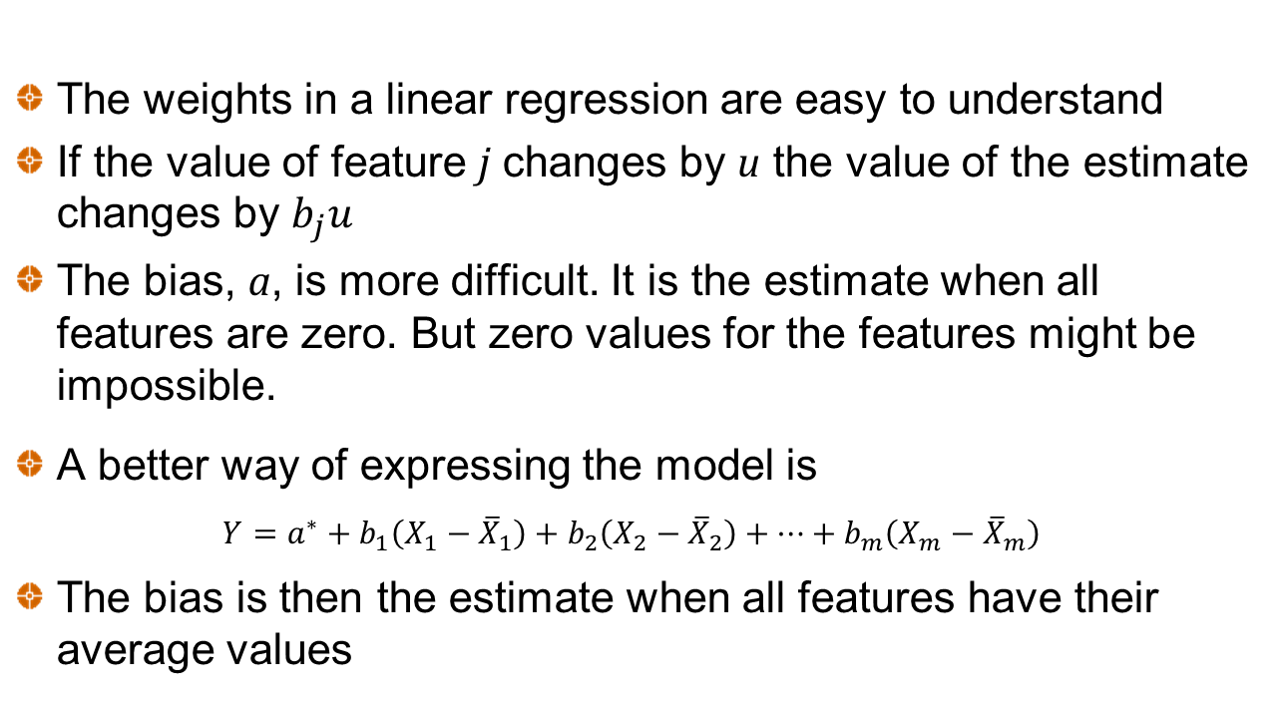
Linear Regression
The weights in a linear regression are easy to understand
If the value of feature j changes by u the value of the estimate changes by $b_{j}u$
The bias, a, is more difficult. It is the estimate when all features are zero. But zero values for the features might be impossible.
A better way of expressing the model is
$$Y=a^{∗}+b_{1}\left(X_{1}−{\overline{X}}_{1}\right)+b_{2}\left(X_{2}−{\overline{X}}_{2}\right)+…+b_{m}\left(X_{m}−{\overline{X}}_{m}\right)$$
The bias is then the estimate when all features have their average values
$$Y=a+b_{1}X_{1}+b_{2}X_{2}+…+b_{m}X_{m}$$

Slide 6
Calculating feature contributions in linear regression
We can compare a currently observed feature value with the average feature value to determine the contribution of that feature to the total value.
The sum of the contributions equals the difference between the current prediction and the prediction when all features have their average values
Results for Iowa house price (Lasso model; first 4 features)

Slide 7
Feature Dependence
Even in the Lasso model there is some dependence between features
Total basement sq. ft. and first floor sq. ft. are not independent and it may not make sense to consider the effect of changing one without changing the other
This is a problem in all models
We might be able to group features that should be considered together. Sometimes a PCA is used to create uncorrelated features.

Slide 8
Logistic Regression
$$Prob \left(Positive Outcome\right)= \frac{1}{1+exp\left[\left.−{(}a+b_{1}X_{1}+b_{2}X_{2}+…+b_{m}X_{m}\right)\right]}$$
$$Prob \left(Negative Outcome\right)= \frac{exp\left[\left.−{(}a+b_{1}X_{1}+b_{2}X_{2}+…+b_{m}X_{m}\right)\right]}{1+exp\left[\left.−{(}a+b_{1}X_{1}+b_{2}X_{2}+…+b_{m}X_{m}\right)\right]}$$
We can calculate the sensitivity of these to the feature values but the result is only good for small changes
For large changes we can use the formulas multiple times

Slide 9
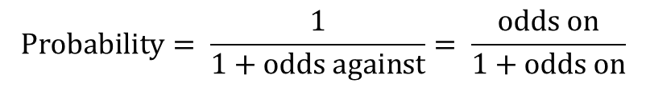
Odds
Odds of a positive result is
or
$exp\left[−⁡(a+b_{1}X_{1}+b_{2}X_{2}+…+b_{m}X_{m})\right]$ to 1 against
$exp(a+b_{1}X_{1}+b_{2}X_{2}+…+b_{m}X_{m})$ to 1 on
$$Probability= \frac{1}{1+odds against}= \frac{odds on}{1+odds on}$$
If we are prepared to work we log(odds) we have linearity and can proceed as for linear regression

Slide 10
Black-box models
Models must be re-run to determine the impact of the change in a feature value on a prediction
In general there is non-linearity so that when changes are made to the feature values the sum of the contributions of the features does not equal the change in the prediction

Slide 11
Partial Dependence Plot
The partial dependence plot is the expected prediction as a function of the value of a particular feature.
The values of all features except the one under consideration are chosen randomly

Slide 12
Shapley Values
Shapley values are a particular way of calculating feature contributions so that the sum of the contributions equals the change that is being explained
They are based on the work of Lloyd Shapley in game theory

Slide 13
Example: Features are changed from “average” to “current values”
Feature 1 Value | Feature 2 Value | Feature 3 Value | Prediction
Average | Average | Average | 100
Average | Average | Current | 120
Average | Current | Average | 125
Average | Current | Current | 130
Current | Average | Average | 110
Current | Average | Current | 128
Current | Current | Average | 137
Current | Current | Current | 140

Slide 14
Consider all the sequences in which changes can happen and average the contributions
Total contribution = 40 which is the total change in the prediction

Slide 15
Properties of Shapley values when used as contributions
If a feature never changes the prediction, its contribution is zero.
If two features are symmetrical in that they affect the prediction in the same way, they have the same contribution.
For an ensemble model where predictions are the average of predictions given by several underlying models, the Shapley value is the average of the Shapley values for the underlying models.
Calculation time increases exponentially with the number of features

Slide 16
LIME
LIME tries to understand a black-box model by fitting a simpler model to data that is close to the currently observed data
Procedure is:
Perturb feature values to get a samples
Run black-box model to get predictions for samples
Train an easy to interpret model such as linear regression or decision trees to fit the data set that is created from samples and predictions

